Slide 1
Heat-Responsive Microgel Anti-Foulant Coatings for Water Purification Membranes
Andrea Kraetz, Chemical Engineering
Mentor: Dr. Mary Laura Lind Thomas, Associate Professor, Chemical Engineering
School for Engineering of Matter, Transport, and Energy, ASU

Slide 2
Reverse Osmosis Membrane
Applied pressure forces contaminated water through membrane.
Membrane structure allows water through, but prevents the flow of contaminants.
Structure of the membrane determines selectivity.
Flux of the membrane is the amount of water through the membrane per area per time.
Figure 1. Typical reverse osmosis system
Figure 2. Typical structure of a reverse osmosis membrane.
Notes:
-Introduce need for water purification
-Flux of water through membrane –amount of permeate per unit area of membrane per unit time
-importance of the membrane in the process
-structure of membrane
-Transition to foulants

Slide 3
Fouling
Figure 3. Fouled membrane surface
As contaminants build up on one side of the membrane, it produces a layer on the membrane surface.
Fouling layer prevents water from traveling through membrane.
Reduces the flux of the membrane and requires additional pressure to push water through, reducing efficiency.
Anti-fouling coatings are being developed to prevent this.
Notes:
Balance of antifouling coatings to flux
Antifoulant types

Slide 4
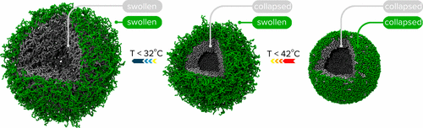
Microgel
Figure 4. Swelling of microgel due to temperature¹
Colloidal substance that is highly responsive to outside stimuli.
Shrinks at higher temperature.
Microgel can be used as an anti-foulant coating through functional group binding to foulant and as a physical barrier between the foulants and the membrane surface.
When it shrinks in higher temperatures, foulants on the microgel will be removed.
¹F. A. Plamper and W. Richtering, "Functional Microgels and Microgel Systems," Accounts of Chemical Research, vol. 50, no. 2, pp. 131-140, 2017.
Notes:
Explain colloidal

Slide 5
Experiment
Figure 5. Experimental process for testing microgel as an anti-foulant
Membrane dip coated with microgel
Coated membrane with fluorescent bovine serum albumin (BSA)
Exposed membrane surface to heated water in cross flow (60°C) at low flow rate (0.4L/h) under fluorescent microscopy
Notes:
Images taken from microscope
ImageJ to analyze fluorescent intensity

Slide 6
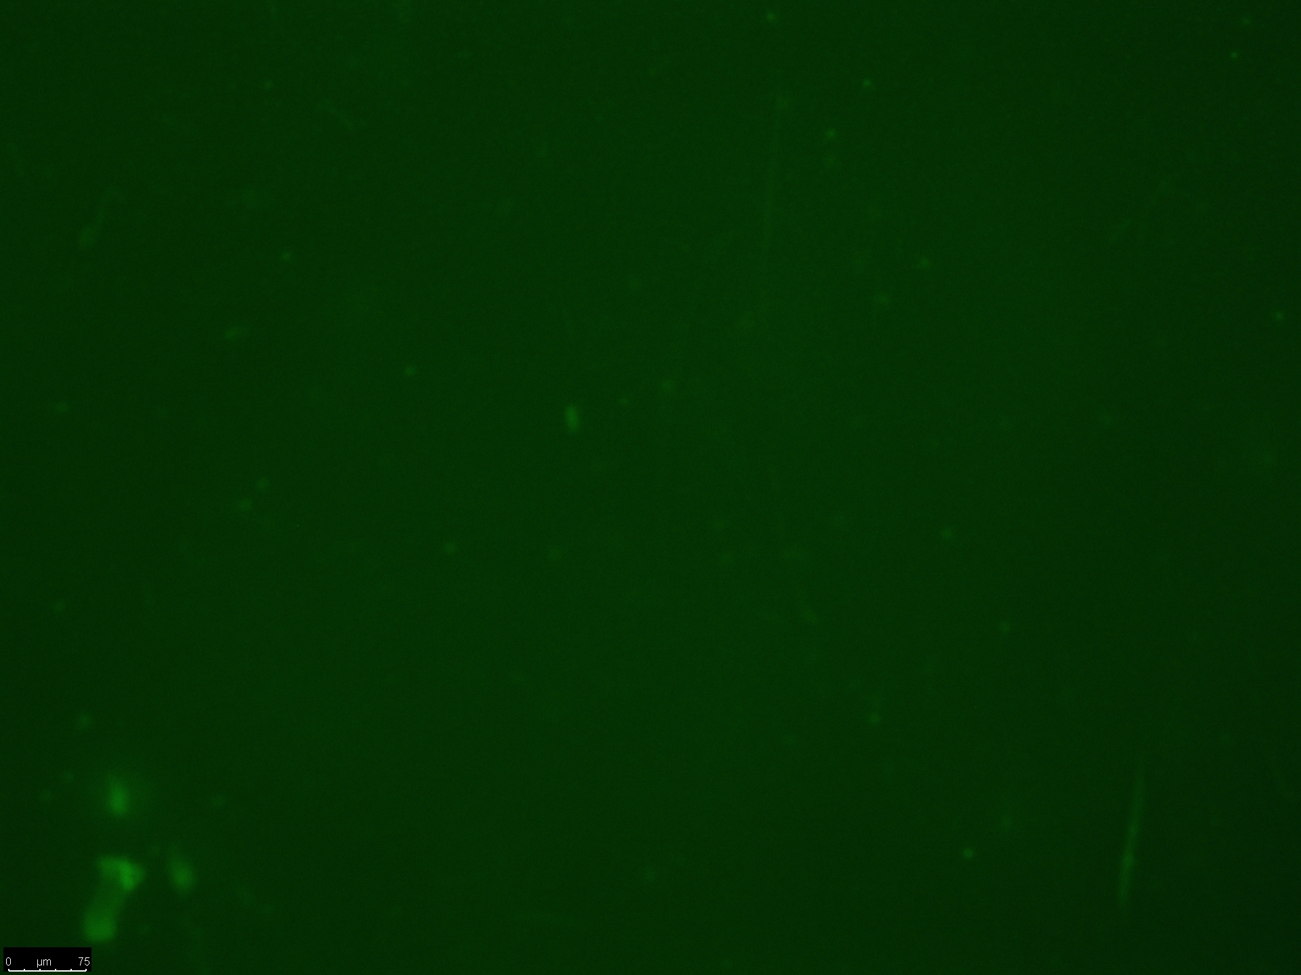
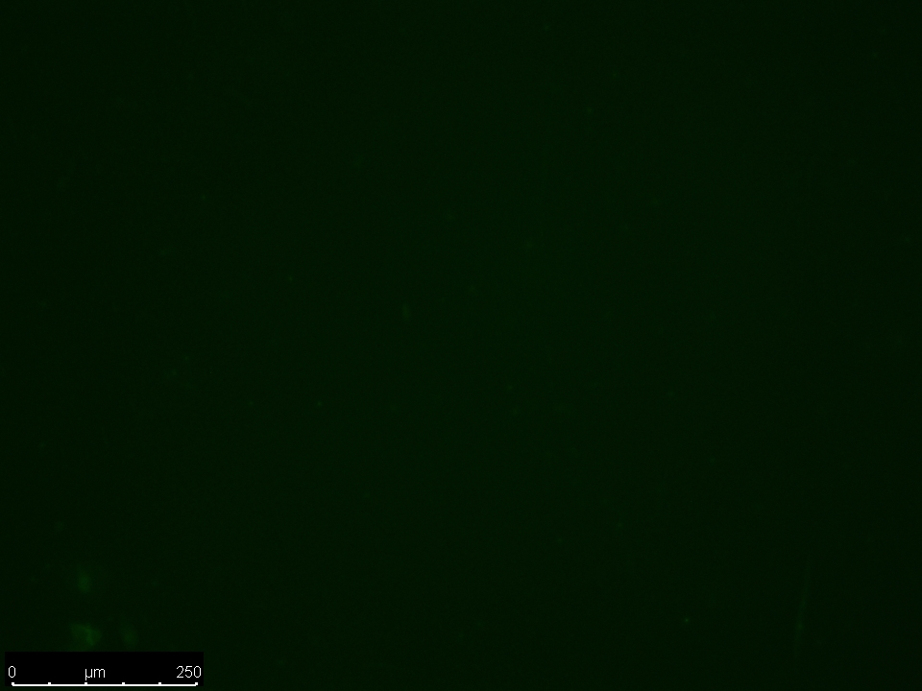
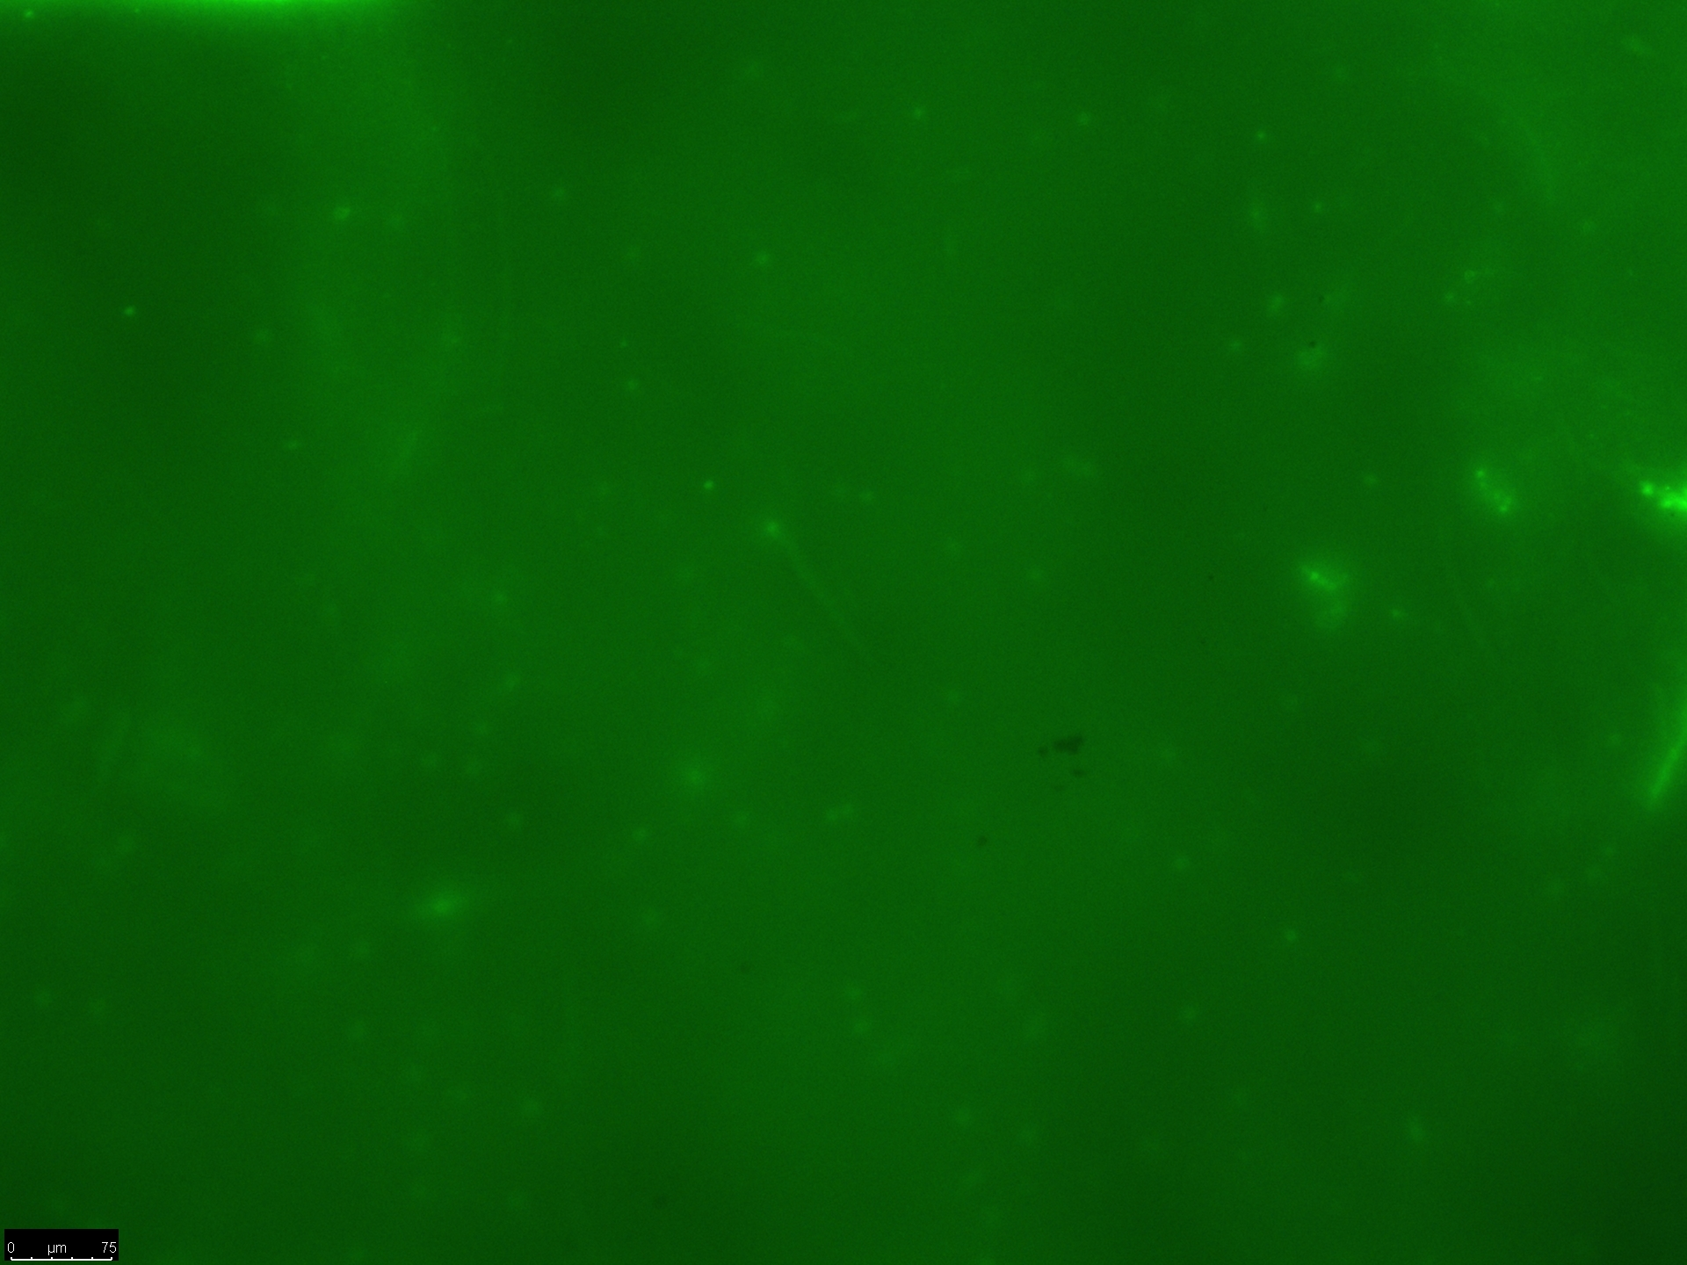
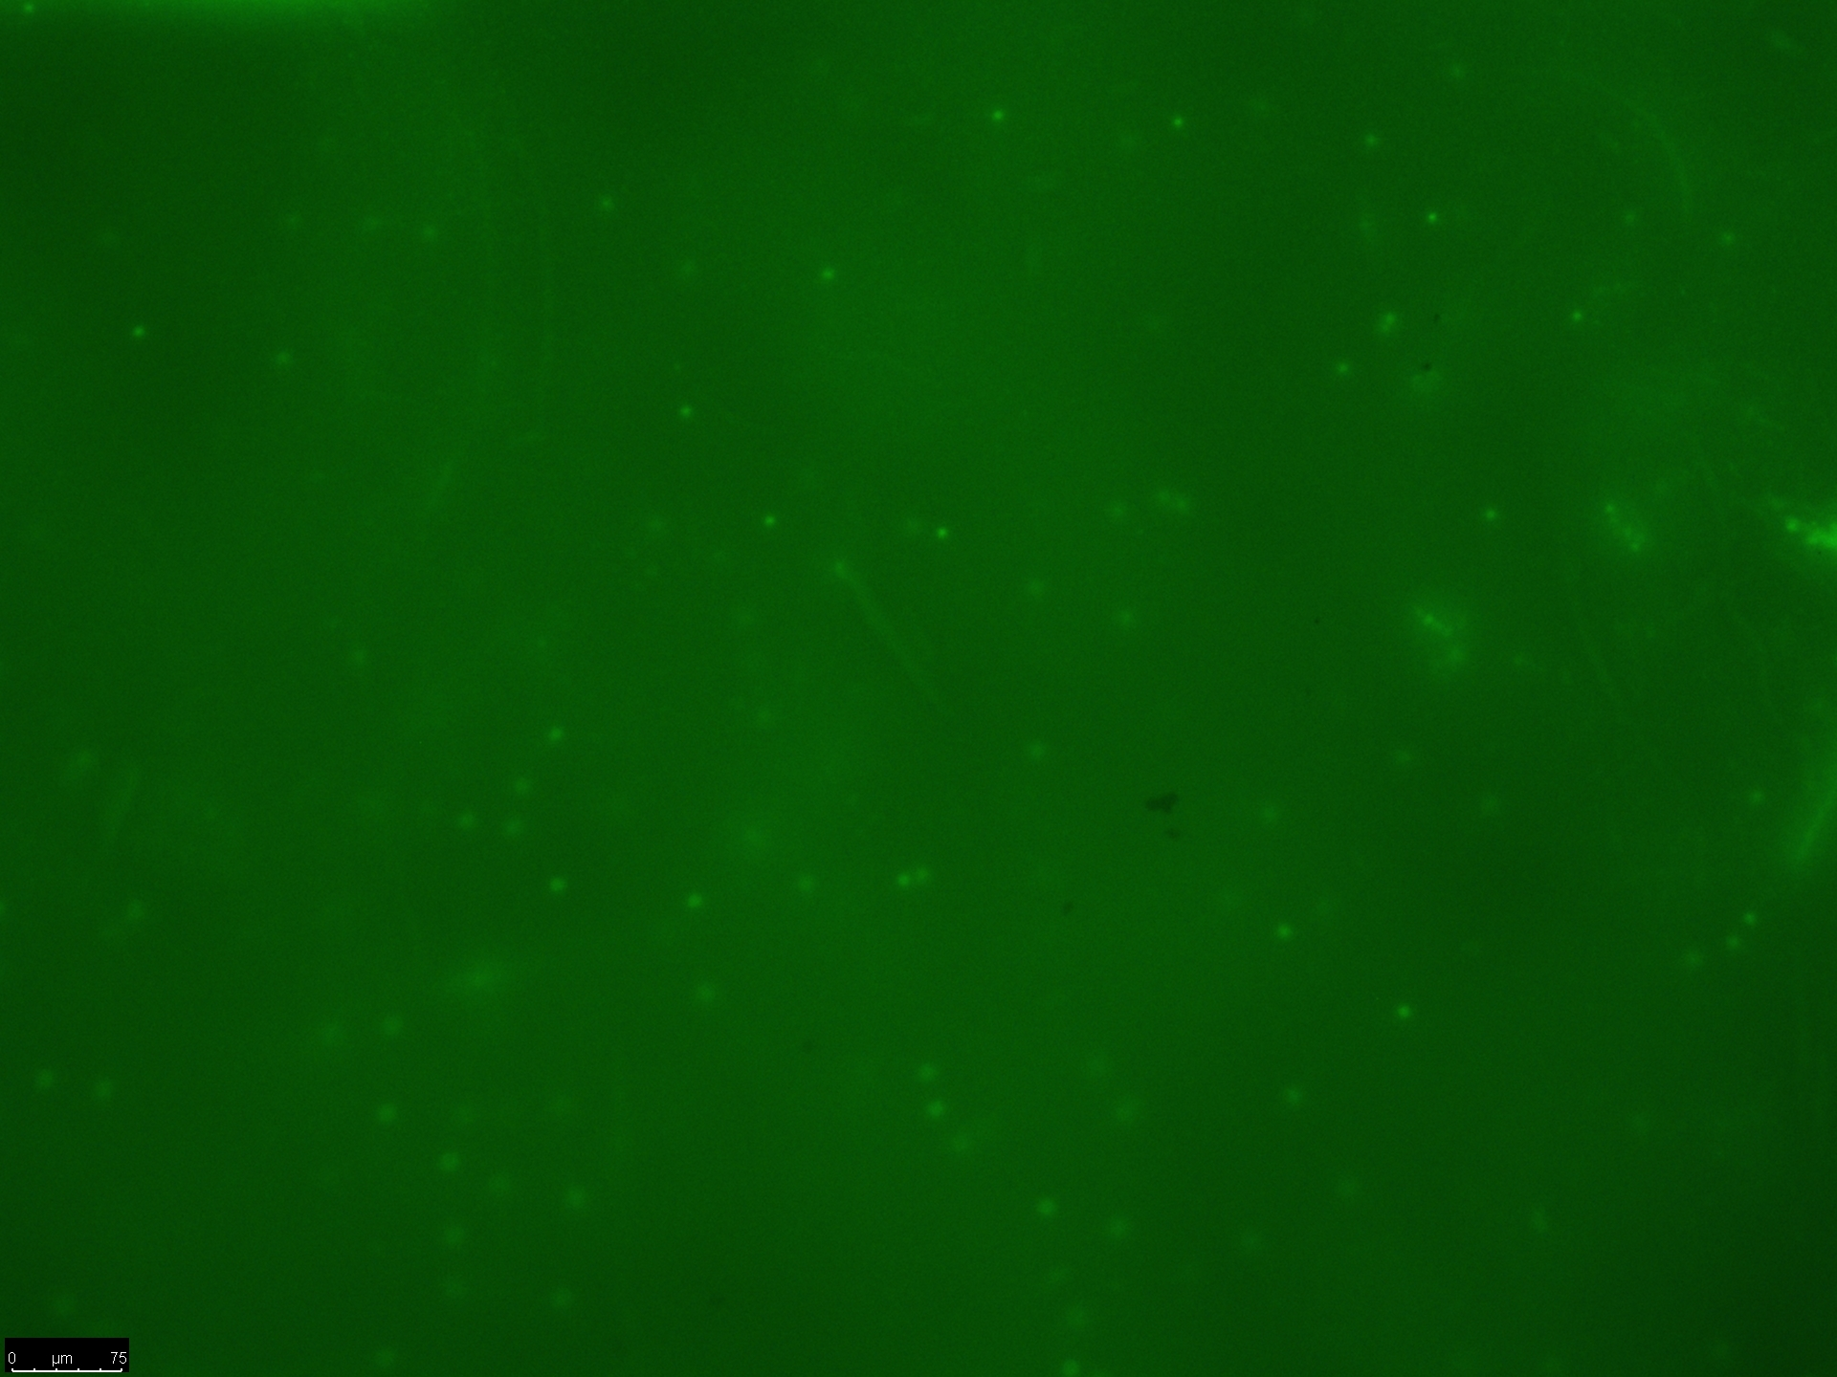
Results
6a
6b
Figure 6. Image of microgel coated membrane with fluorescent BSA with a) the initial amount of fluorescence and b) the amount after 20 minutes of hot water
7a
7b
Graph 1. Indicates the amount of fluorescence remaining after 20 minutes of crossflow with hot water
Figure 7. Image of bare membrane with fluorescent BSA with a) the initial amount of fluorescence and b) the amount after 20 minutes of hot water

Slide 7
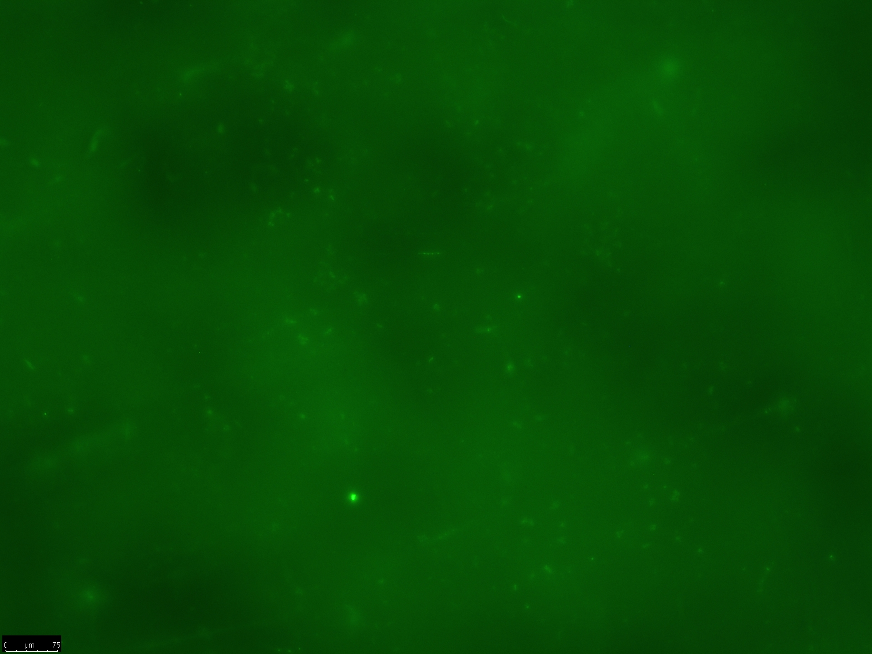

Membrane Functionalization
Under reverse osmosis, microgel came off the membrane surface due to high pressures.
Creates the need to functionalize membrane surface in order to chemically bond the microgel to the membrane surface.
Functionalization could effect the performance of the membrane.
8a
8b
Figure 8. Image of functionalized microgel membrane with fluorescent BSA with a) the initial amount of fluorescence and b) the amount after 20 minutes of hot water

Slide 8
Future Work
Conduct reverse osmosis tests on the functionalized membranes to determine if the microgel remains in the surface under these conditions.
Test microgel performance with various foulants.
Develop additional methods for the uniform coating of microgel on membrane.

Slide 9
Acknowledgements
My mentor Dr. Mary Laura Lind for the advice and resources she has provided me with and for the many hours she has spent reviewing my work.
Dr. François Perreault for his assistance and for the use of his laboratory and equipment.
Dr. Lenore Dai for her expertise and the use of her microgel.
Kaushik Londhe, Wendy Lin, and Doug Rice the graduate students, that have spent time developing experiments and training me.
Support from the ASU/NASA Space Grant Program.

Slide 10
Thank you! Questions?

